Slide 1
Jane Mburu
Lending Club Assignment

Slide 2
Project goal
The goal of the Lending Club project is to analyze the lending data to gain insights that can :
1. Improve decision- making
2. Enhance Profitability
3. Mitigate Risks

Slide 3
Lending Club Background
A peer-to-peer lending platform connecting investors to borrowers.
Borrowers could acquire up to $40,000 of unsecured personal loans
Investors consider things such as amount of loan, loan grade, and purpose before investing.
Investors make money from interests on loans awarded.
LendingClub make money by charging borrowers an origination fee, and investors a service fee.
LendingClub determined a borrowers creditworthiness based on their credit score, credit history, desired loan amount, and debt-to-income ratio

Slide 4
Business Problem
The goal of any financial institution is to make money. But there is always a risk involved when it comes to evaluating reliability of borrowers.
If a loan applicant is likely to repay a loan, then not approving them becomes a loss for the business.
Alternatively, approving an applicant that will likely default on a loan leads to a potential loss for the business.
Mitigating these risks is critical, and lenders should thoroughly assess the risk of a loan application to avoid future money losses.

Slide 5
Guiding Questions
How has the trend of loan approvals changed over the years, and what factors might be contributing to these changes?
How does the count of approved loans vary by grade, and what is the corresponding average interest rate for each grade?
How does loan distribution of loans vary across different states, and what is the relationship between loan amount and installment amounts?
How has the distribution of good and bad loans varied over the years, and what does this reveal about risk management practices and borrower behaviors?

Slide 6

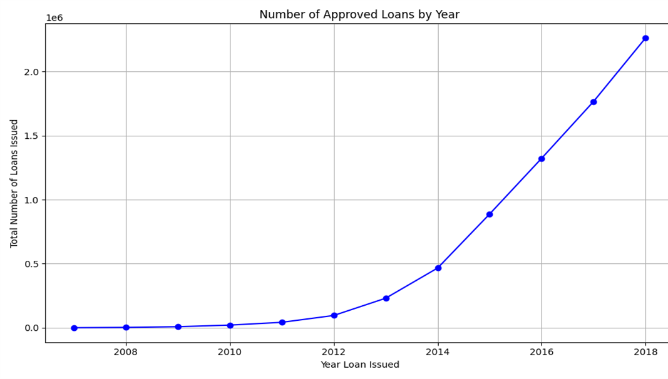
Number of Approved Loans by Year
Number of approved loans appears to increased rapidly from 2013.

Slide 7
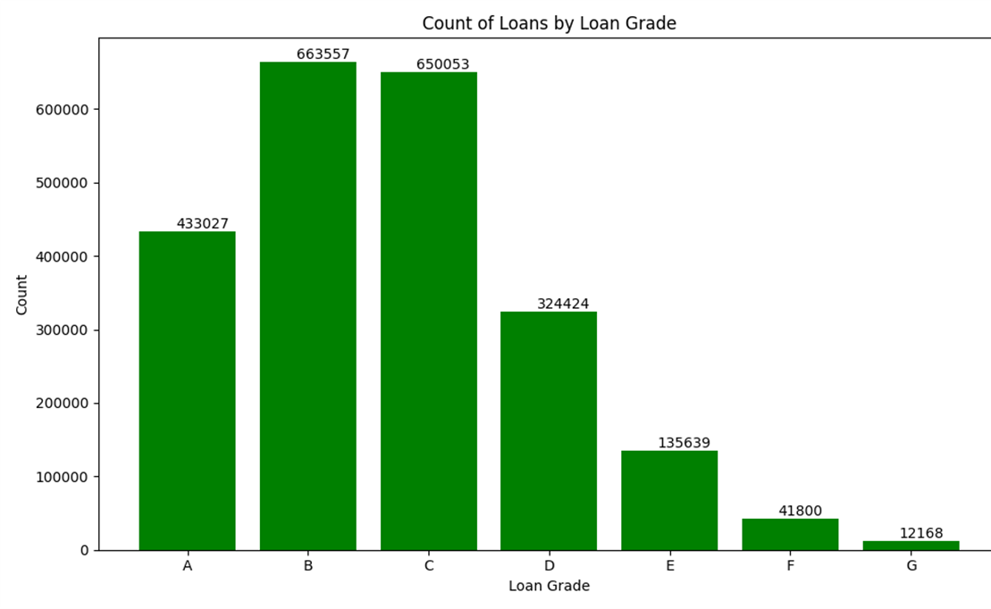
COUNT of Approved Loans by GRADE
Grade A is the safest loan, loan G is the riskiest.
Loan grades B and C are the most qualified by the LendingClub.

Slide 8
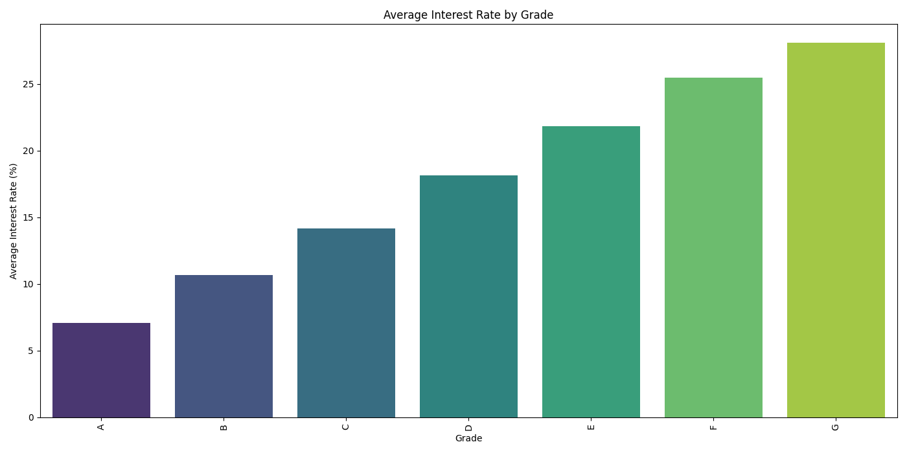
AVERAGE INTEREST RATES by GRADE
Interest rates tend to increase with higher loan grades.
Grade A has the lowest interest rate, whereas Grade B exhibits the highest interest rate.

Slide 9
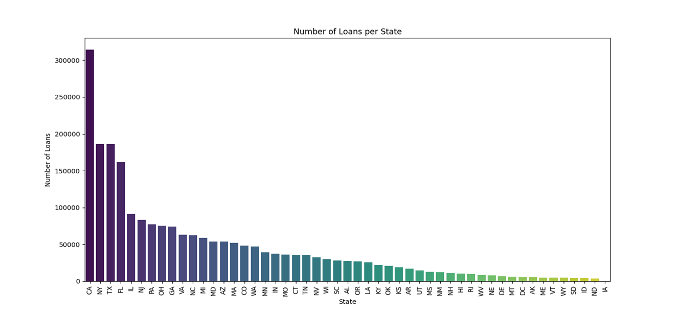
NUMBER OF LOANS BY STATE
Distribution of loans vary across states with California leading in the number of approved loans.

Slide 10
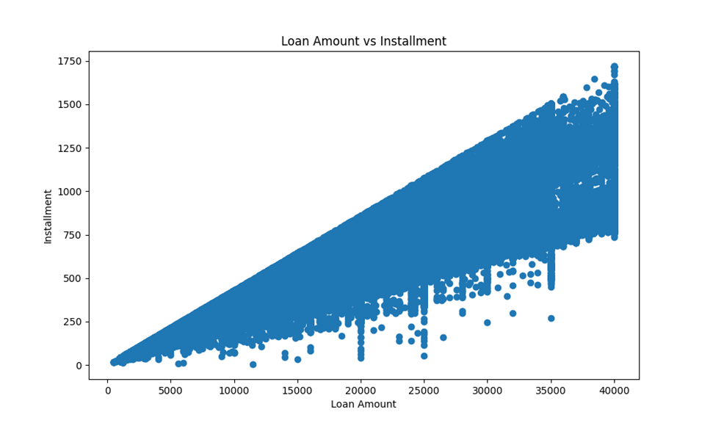
Loan amount vs installment
As the loan amount increases, the installment amount also increases.

Slide 11
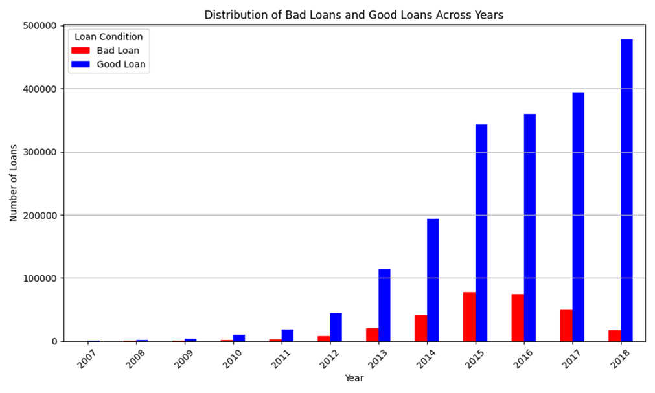
Good Loans vs. bad loans
Good loans are significantly higher than bad loans across the years.
Concentration of bad loans in 2015 and 2016.

Slide 12
Key findings
Number of approved loans increased rapidly from 2013. This indicates a growing demand for loans.
Grade A is the safest loan with the lowest interest rates, thus desirable to the investors.
Loan G is the riskiest, reflecting a higher interest rates, this may also attract investors seeking higher returns and willing to accept risk.
Loan grades B and C are the most qualified by the LendingClub, suggesting a balance between risk and return acceptable by both the investor and borrower.

Slide 13
Interest rates increase with higher loan grades. The riskier the loan, the higher the interest rate.
Distribution of loans vary across states with California leading in the number of approved loans.
There is a correlation between loan amounts and installment amounts. As the loan amount increases, the Installment amount also increases proportionally.
Good loans(current and fully paid) are significantly higher than bad loans across the years. However, there is a slight concentration of bad loans in 2015 and 2016.

Slide 14
implications
Investors should understand the risks and returns associated with different loans as this can help them make informed decisions.
Lending Clubs should invest in thorough practices when determining the creditworthiness of potential borrowers to avoid losing money.

